Slide 1
Quantification Software Usage and Troubleshooting
September 4, 2026

Slide 2
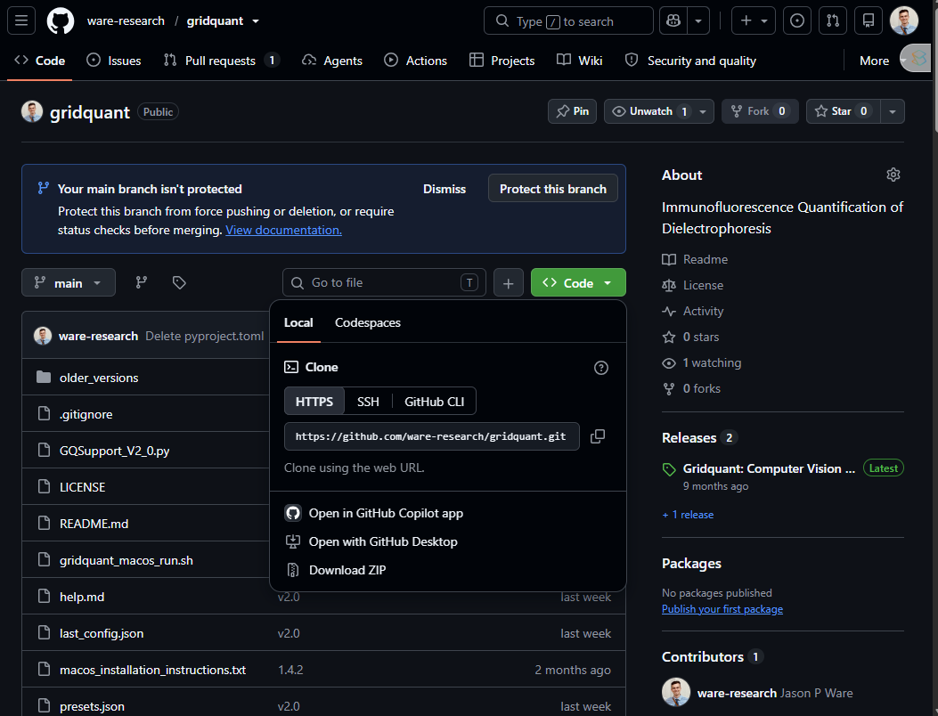
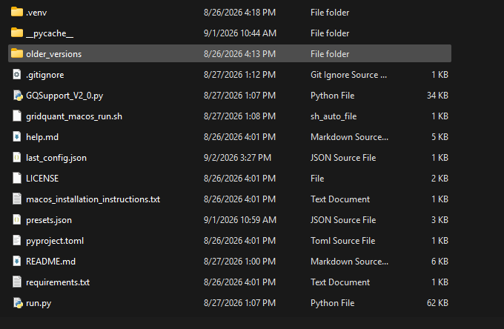
Download the Newest Version
https://github.com/ware-research/gridquant

Slide 3
Set up python environment
I strongly recommend “uv”
https://docs.astral.sh/uv/getting-started/installation/
Set up .venv (for uv)
Into command line at the current directory:
> “uv venv”
> “uv pip install –r requirements.txt”
To run software:
> “uv run run.py”

Slide 4
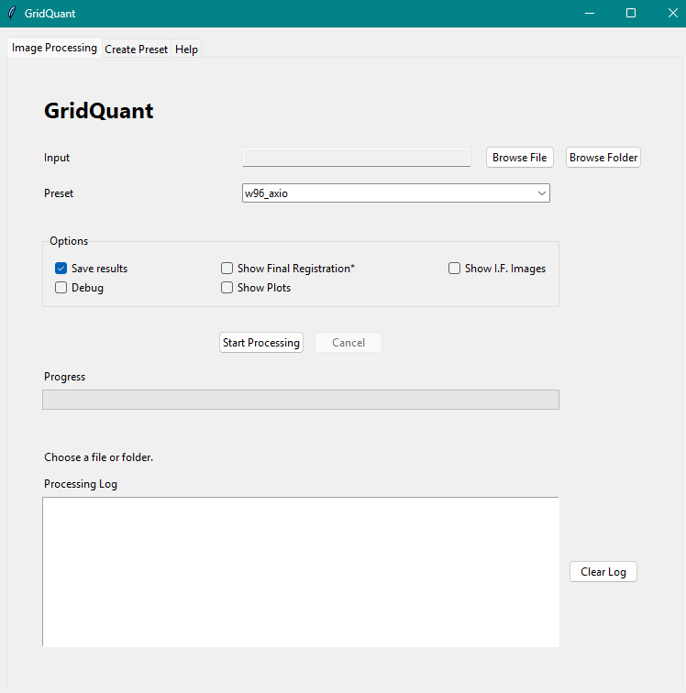

Slide 5
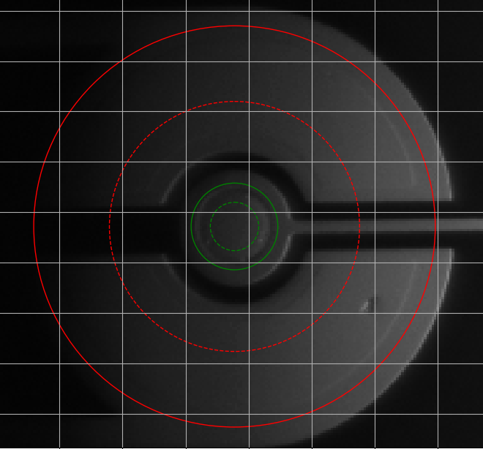
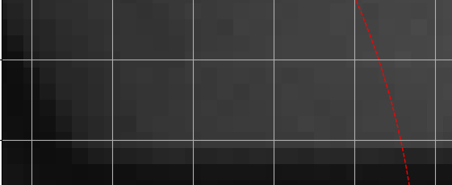
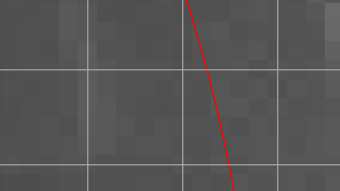
18px
8px

Slide 6
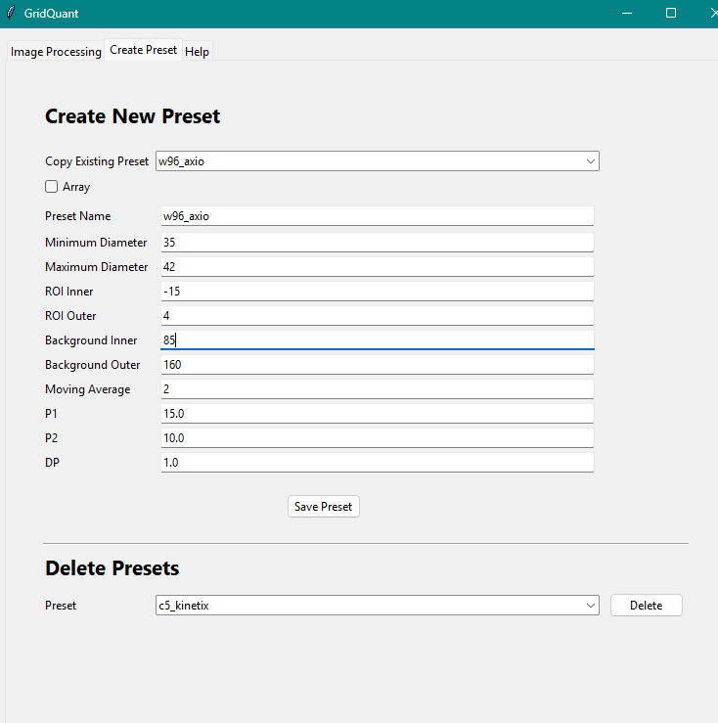
85-(18x2) = 49

Slide 7
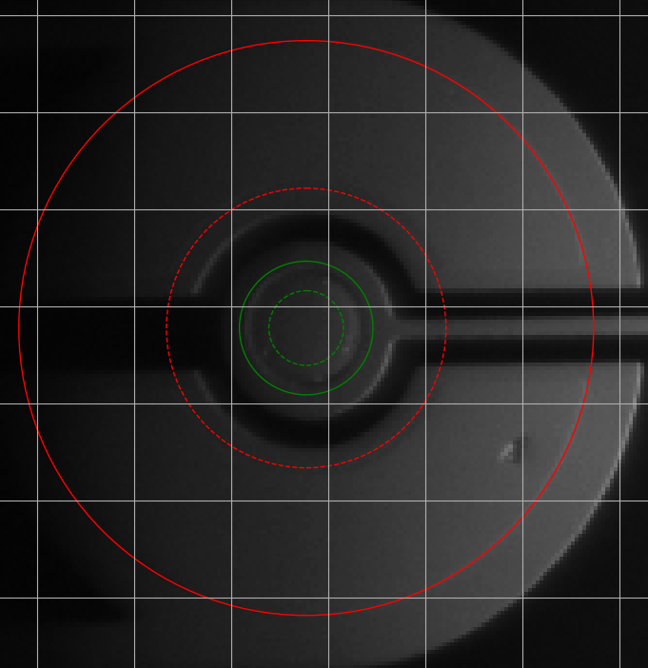

Slide 8
Troubleshooting initial circle finding
Make sure you are using the correct preset for your experiment
Measure and adjust “Minimum Diameter” and Maximum Diameter”
Find circle diameter and add +5 for max, and -5 for min.
Adjust “P1” if no circles are found (Lower values finds more circles)
Adjust “P2” until the correct circle is found (Lower values select less-defined circles”

Slide 9
